Slide 1
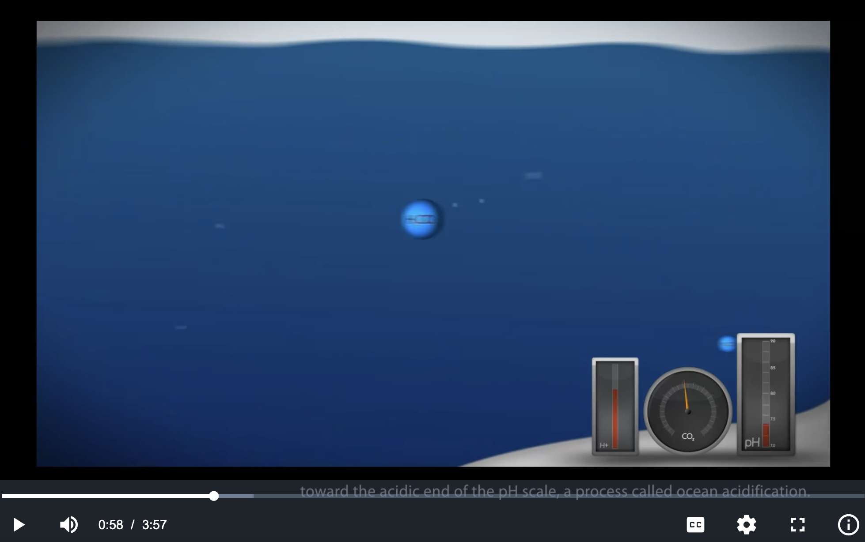
Impacts of ocean acidification
https://en.wikipedia.org/wiki/Ocean_acidification

Slide 2
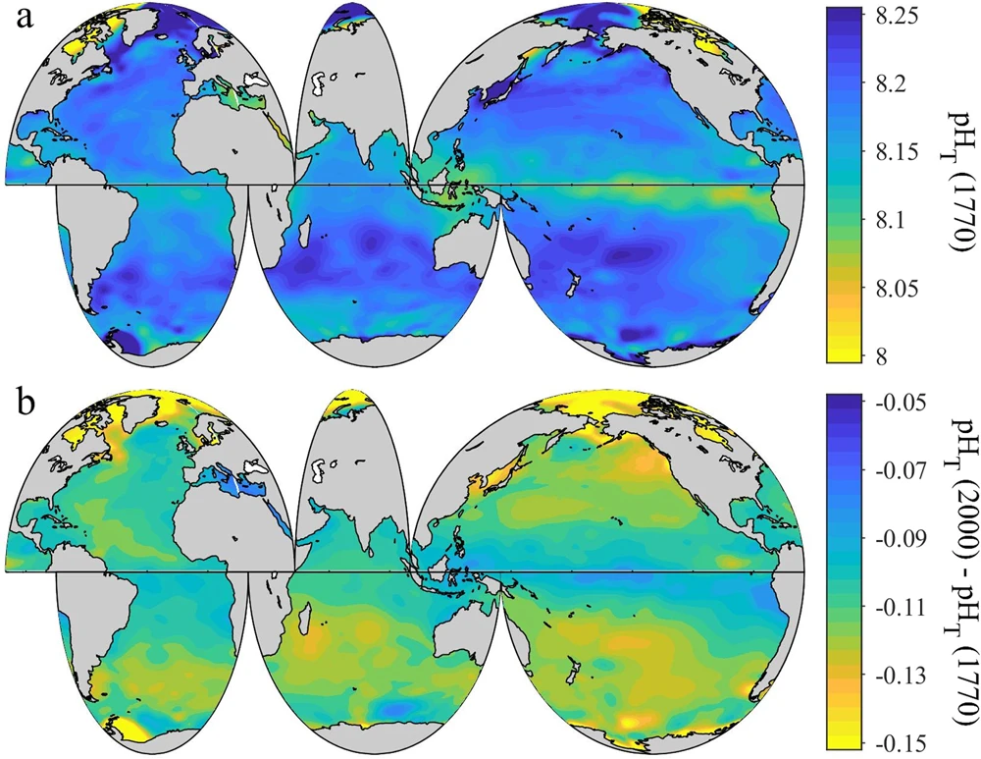
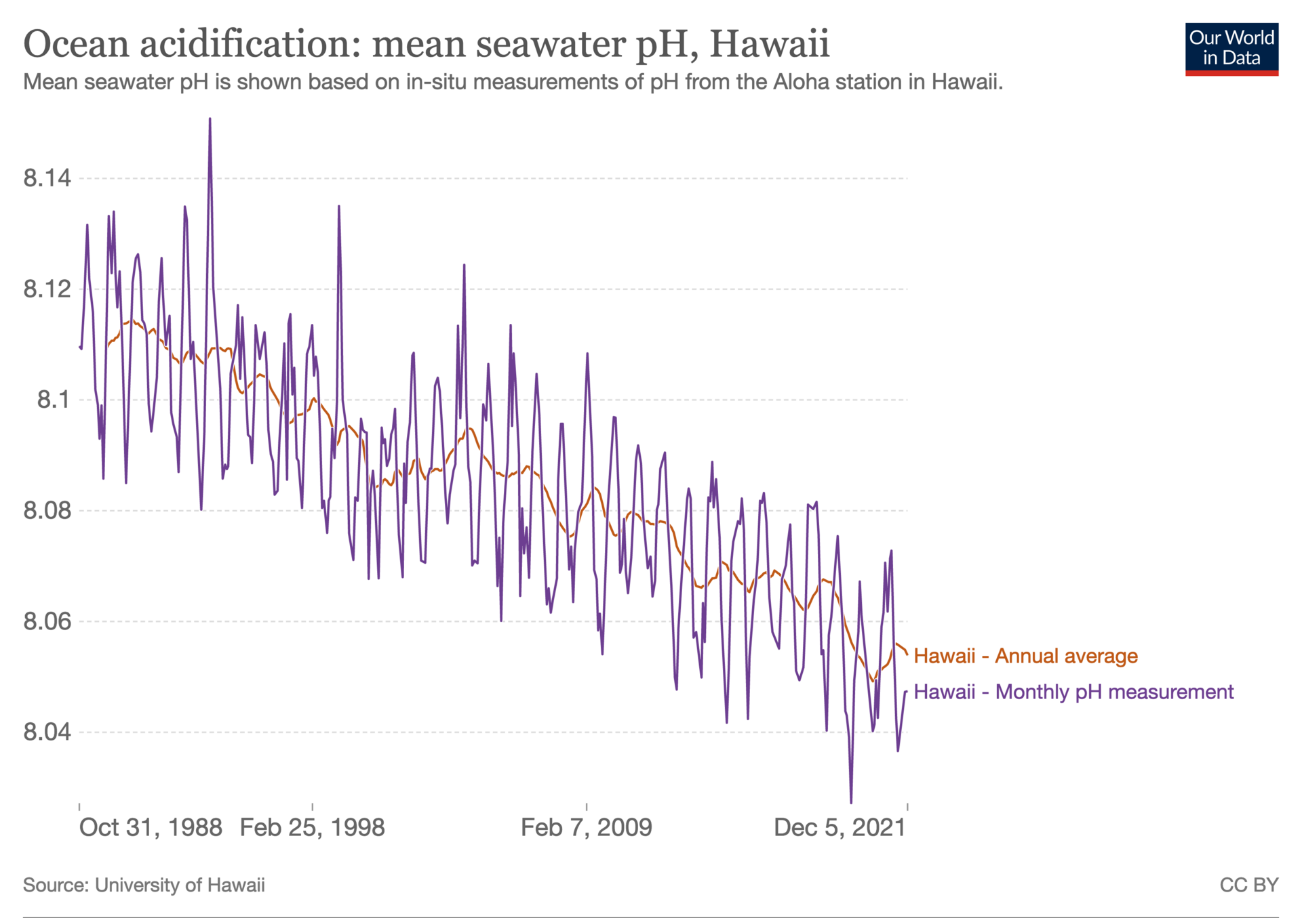
Trends in ocean acidification

Slide 3



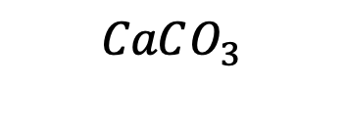








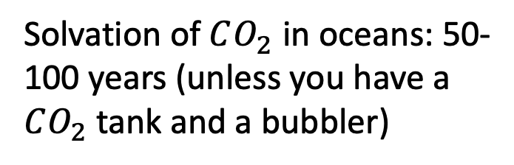
Time scales of these reactions
$$CO_{2}$$
Solvation of $CO_{2}$ in oceans: 50-100 years (unless you have a $CO_{2}$tank and a bubbler)
Air
$$H_{2}O$$
$$H_{2}O$$
Oceans
$H_{2}CO_{3}$
$$H^{+}$$
$$H^{+}$$
Ocean chemistry: minutes or days
$$HCO_{3}^{−}$$
$${Ca}^{2+}$$
$$CO_{3}^{2−}$$
Dissolving $CaCO_{3}$ (limestone) from the sea floor: thousands of years (unless you have concentrated HCl handy)
Sea floor
$$CaCO_{3}$$
$$CaCO_{3}^{}$$

